Slide 1
Sean Koppenhafer, Jaime Rodriguez,
Chad Thueson, Noah Erickson, Rishal Dass
Weekly meeting, 06/3/2015
Digital Dash
Portland State University
Department of Electrical and Computer Engineering (ECE)
Notes:
1
1

Slide 2
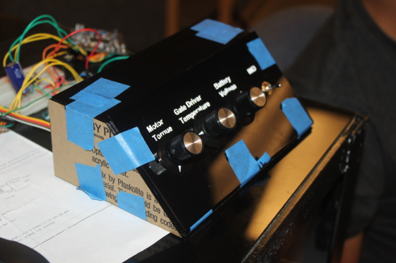
Demo Unit
Final demo unit enclosure finished
New Arduino Due programming correctly
Laggy update time screen, probably custom board related (we will solve this Tuesday night by creating a new custom board)
Demo code on vehicles eVCU is working
Still need to troubleshoot polling code, should solve system freeze up

Slide 3
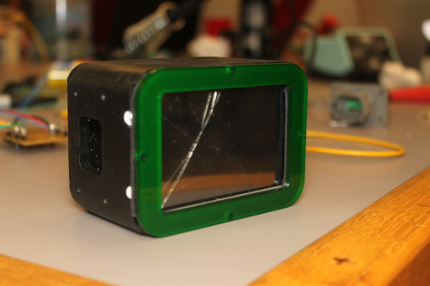
VMS Digital Dashboard
Final Code
Screen has been locking/freezing up
Need to test out polling code once new custom board is populated
Enclosure completed
Cut out of ¼” acrylic
Removable green faceplate for component access
Need to create mounting bracket and cut out holes on the vehicles dash (to be completed Tuesday night)
Custom Board
Populating new board that will be cleaner than previous board
Onboard programmer functioning

Slide 4
Documentation
Poster received and mounted to backing
Sponsor presentation is prepared
Michal’s wiki changes are completed and repository organized
User manual is complete
No progress on report

Slide 5
Goals For The Next Two Days
Documentation
Present to VMS team Thursday, June 4th at 2PM in the ECE conference room
Capstone poster session on Friday, June 5th
Finish report
System
Prevent screen from locking up
Install on car
Mighty mugs when finished or all hope is lost
Notes:
5

